Slide 1
Artistic Style Transfer Using Deep Learning
Group Members:
Meet Chheda (60003140008)
Pankil Daru (60003140010)
Siddhant Gada (60003140019)
Project Guide:
Prof. Purva Raut

Slide 2
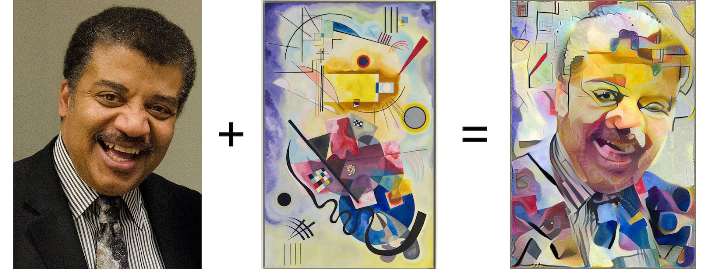

Concept
Content
Style
Output

Slide 3
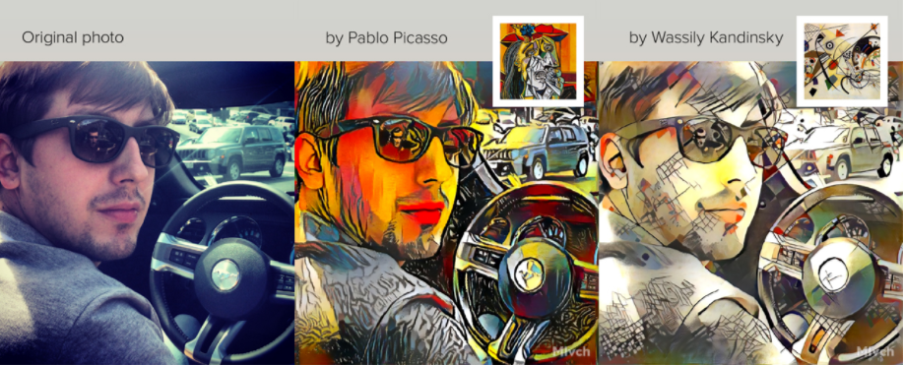
Existing System
Prisma
Deepart.io
Snapchat
Prisma using Neural Style Transfer Algorithm

Slide 4
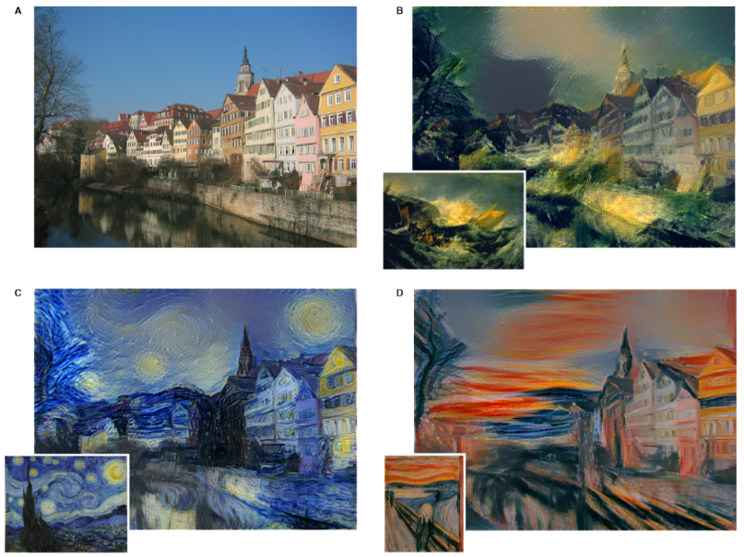
Literature Survey
In 2015, L.A Gatys et al. demonstrated power of Convolutional Neural Networks (CNN) in creating artistic fantastic imagery by separating and recombining the image content and style.
In 2016, L.A Gatys et al. devised a model for rendering the semantic of an image in different styles. They used image representation derived from CNN optimised for object recognition, which makes high level image information explicit.

Slide 5
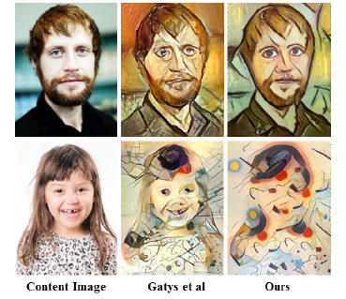
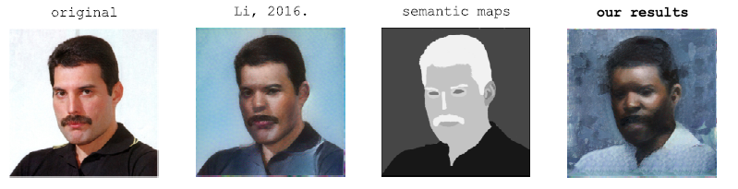
In 2016, Li and Wand used an alternative to gram matrices, which is, a patched based approach, which also operates on the output of convolution layers. Following figure shows comparison of Gatys and
their model.
In 2016, Alex J. explored the concept of Neural Doodle where they get artistic results from MS Paint style doodles. Applications included semantic style transfer and turning doodles with few colors into masterful paintings.

Slide 6
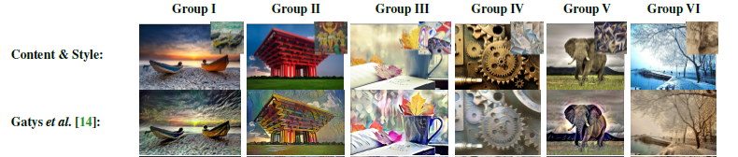
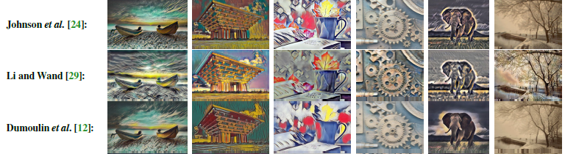
Comparison of Various Research Works

Slide 7
Drawbacks of Existing Systems
However, these models had certain shortcomings:
Current models apply style image to the complete content image.
Predefined number of styles.
Can not use multiple styles on a single base image.

Slide 8
Problem Definition
We introduce a deep-learning approach to photographic style transfer that handles any variety of image content that a user clicks while transferring the reference style.
User option of entering his style
Apply multiple styles on a single image
Apply multiple styles on multiple parts of the content image

Slide 9
Scope
Features:
User choice content and style image: User will get an option to choose a content image and a style image.
Option of choosing multiple style images: If he wishes, he can add various styles to the image.
Option for choosing the area where the multiple styles needs to be applied: The styles would be only used in those area selected by the user.

Slide 10
Project Resources
Hardware Resources:
A laptop or PC with i7 Intel CPU and NVIDIA GeForce GTX 1060 GPU (minimum).
Minimum 8 GB RAM (minimum).
Software Resources:
Anaconda.
Python 2.7+.
Operating Environment:
User will be provided CLI to enter the path of images.

Slide 11
Estimation
People required : 3
Lines of Codes (KLOC) : 5
Efforts applied: 18.2 man- months
Development Time: 7 months

Slide 12
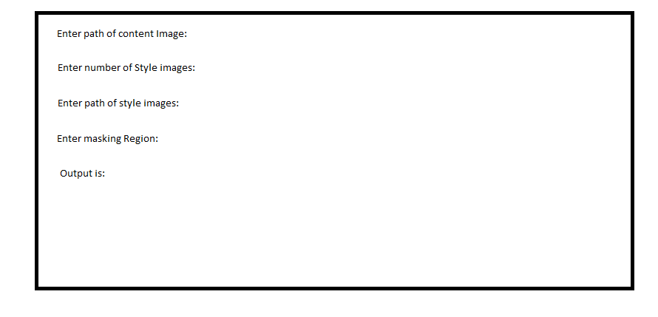
Modular Design
CLI interface:

Slide 13
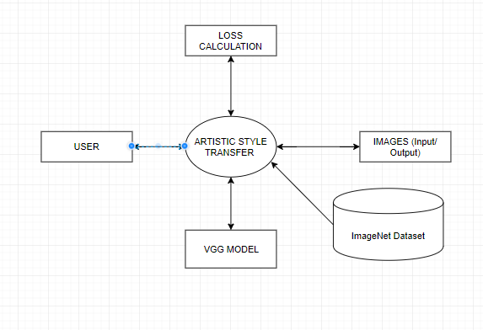
DFD Level 0:

Slide 14
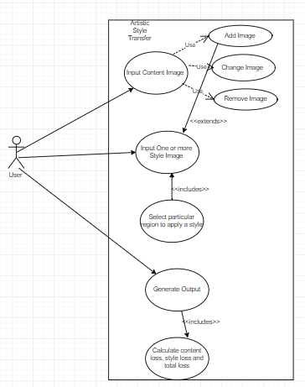
Use Case:

Slide 15
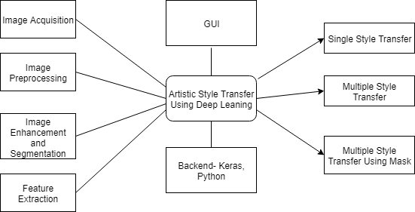
System Architecture

Slide 16
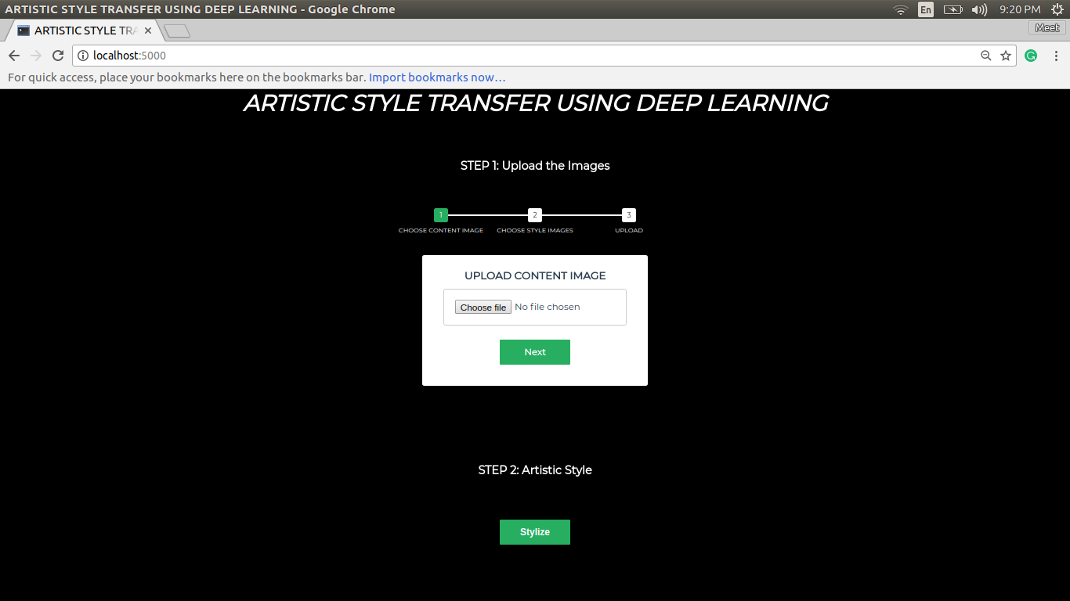
Interface Design

Slide 17
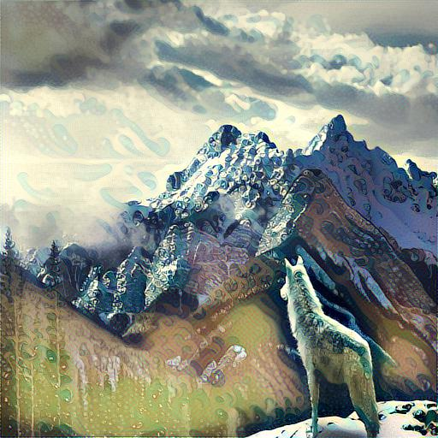
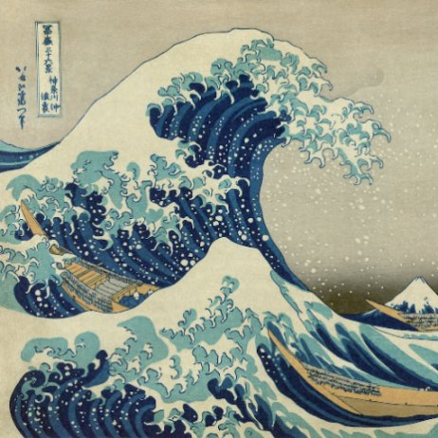
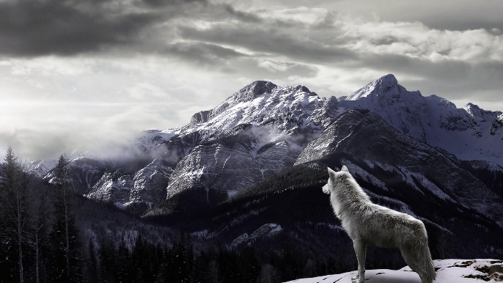
Experimental Result
Content Image Style Image Output Image

Slide 18
Conclusion
Through the proposed project and research, the conclusion drawn is that the new proposed system will overcome the drawbacks of the current system which will help user to generate picturesque image. Using this study we can use the system further in interior designing where the drapes can be designed using our model. It can be also used by game designers to develop environments for the game as game might have same environment with different textures so instead of making the environments again, game designers can use our system to generate environments. This project alleviates any pitfalls of the current existing system.
Since the project is deployed on web, user has a simple user interface to generate an image. The image gets saved on the system so no need of copying the photo while it is displayed on web. With sufficient changing in hyper parameters we can now generate the output image with the minimum loss possible.

Slide 19
References
Leon A. Gatys, Alexander S. Ecker, Matthias Bethge. A Neural Algorithm of Artistic Style. arXiv preprint arXiv:1508.06576, 2015.
Leon A. Gatys, Alexander S. Ecker, Matthias Bethge. Image Style Transfer Using Convolutional Neural Networks. In Computer Vision and Pattern Recognition (CVPR), 2012 IEEE Conference on, pages 2414–2423. IEEE, 2016.
C. Li and M. Wand. Combining markov. Random fields and convolutional neural networks for image synthesis. In IEEE Conference on Computer Vision and Pattern Recognition, pages 2479–2486, 2016.
Alex J. Champandard. Semantic Style Transfer and Turning Two-Bit Doodles into Fine Artwork. arXiv preprint arXiv:1603.01768, 2016.
J. Johnson, A. Alahi, and L. Fei-Fei. Perceptual losses for real-time style transfer and super-resolution. European Conference on Computer Vision, 2016.
V. Dumoulin, J. Shlens, and M. Kudlur. A learned representation for artistic style. ArXiv e-prints, Oct. 2016.
Dmitry Ulyanov, Andrea Vedaldi, and Victor Lempitsky. Instance Normalization: The missing ingredient for fast stylization. arXiv preprint arXiv:1607.08022, 2016.
Prutha Date, Ashwinkumar Ganesan, Tim Oates. Fashioning with Networks: Neural Style Transfer to Design Clothes. arXiv preprint arXiv:1707.09899, 2017.

Slide 20
Thank You

